Slide 1
Power BI Job Simulation Pwc Switzerland

Slide 2
Introduction
This report presents the outcomes and insights gained from completing the Power BI Job Simulation with PwC Switzerland. The simulation provided a hands-on experience that mirrors real-world business scenarios, enabling me to step into the role of a data analyst tasked with transforming raw data into actionable insights.

Slide 3
My Experience
Throughout the program, I was exposed to PwC’s approach to solving client challenges through data-driven storytelling and interactive dashboards. Using Microsoft Power BI, I analyzed customer trends, developed visualizations, and derived actionable insights to improve client decision-making and operational strategies.
This simulation not only strengthened my technical proficiency but also sharpened my ability to align analytics with business needs. Which is an essential skill in today’s data-centric world.

Slide 4
🌍 Task 4: Diversity & Inclusion Analysis

Slide 5
Overview
In the final task of the simulation, the focus shifted to analyzing workforce diversity metrics to support equitable decision-making and inclusive strategy development. Using Power BI, I designed a dashboard that brought visibility into representation gaps, performance disparities, and promotion trends across key demographic dimensions.
The goal was to equip stakeholders with a transparent view of gender balance, age distribution, and performance outcomes across job roles and business units. By surfacing these insights, the dashboard empowered leadership to make data-informed decisions around hiring practices, career progression, and retention strategies, ensuring alignment with broader Diversity, Equity, and Inclusion (DEI) goals.

Slide 6
📚 Dataset Introduction
The dataset used for this analysis consists of approximately 15,000 employee records with 32 column attributes, offering a comprehensive view of workforce dynamics across gender, job levels, performance, promotions, and attrition. It serves as a powerful tool for uncovering trends that impact diversity, equity, and inclusion within the organization.
🧩 Key Attributes Include:
Employee ID – Unique identifier for each employee.
Gender – Classification of employees by gender.
Job Level after FY20 Promotions – Categorized into Junior Officer, Manager, Director, Senior Manager, and Executive.
New Hire in FY20 (Y/N) – Indicates whether the employee was hired during FY20.
FY20 Performance Rating – Evaluation score or category assigned for FY20.
Promotion in FY21 – Denotes whether the employee received a promotion in the following fiscal year.
Target Hire Balance – Reference metric used to measure workforce composition goals.
FY20 Leaver – Identifies if the employee exited the organization during FY20.
Job Level after FY21 Promotions – Captures progression trends post-FY21 evaluations.

Slide 7
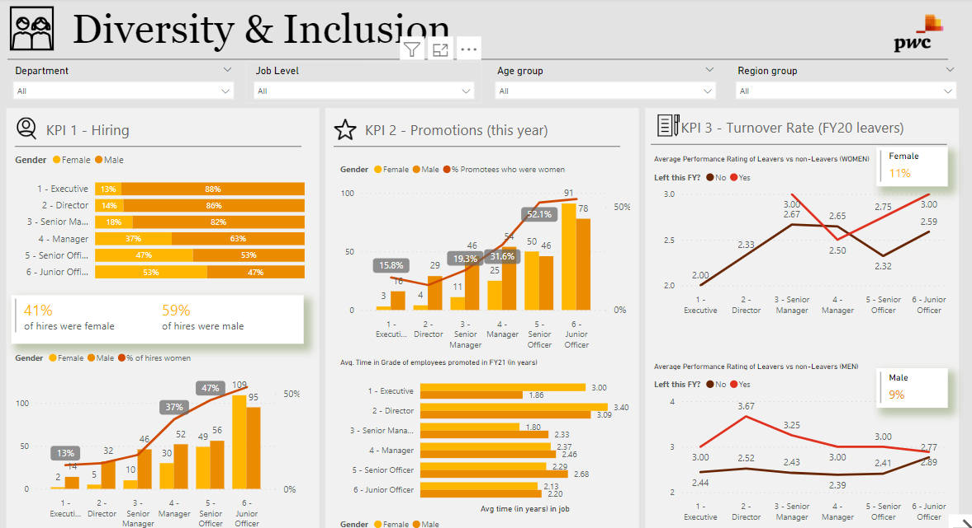
Dashboards 1

Slide 8
📊 Key Insights from Diversity & Inclusion
Gender Disparities in Leadership
Females are underrepresented at senior leadership levels (Senior Manager, Executive), despite balanced entry-level hiring.
While promotions exist, the pace of advancement for women appears slower, indicating potential growth barriers.
FY21 Promotions & Performance
A majority of FY21 promotions were granted to those with high FY20 performance ratings, affirming a merit-based trend.
However, deeper analysis reveals inconsistencies across gender and business units, raising questions about evaluation fairness.
Attrition Trends
Leaver rates are higher among certain job levels and genders, which may signal culture or policy misalignments.
The exit patterns skew towards junior roles, suggesting a possible gap in early-career support or satisfaction.
Hiring Balance vs. Target Goals
Some business units missed the target gender hiring balance, highlighting the need for more deliberate inclusion efforts in recruitment.

Slide 9
✅ Recommendations for Stakeholders
Accelerate leadership development programs for women to address underrepresentation in senior roles and foster balanced progression.
Audit promotion criteria and evaluation processes to ensure performance ratings and advancement are equitably distributed across gender and units.
Strengthen early-career support, especially in junior roles where attrition is highest, through mentoring and growth pathways.
Enhance inclusive hiring practices by aligning recruitment efforts with gender balance targets across all business units.
Introduce pulse surveys or exit interviews focused on underrepresented groups to uncover retention challenges and policy gaps.

Slide 10
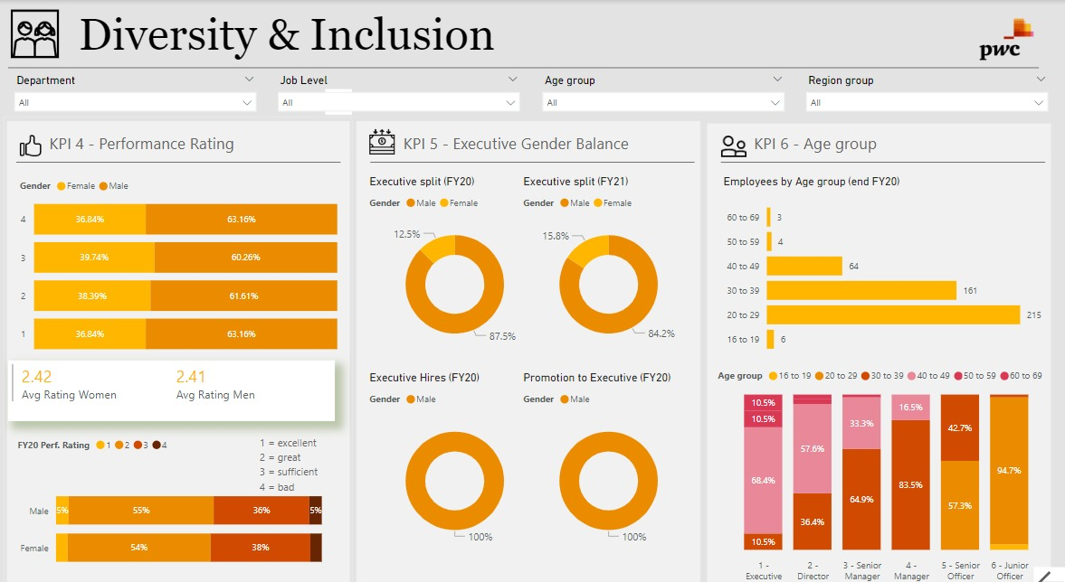
Dashboards 2

Slide 11
📊 Key Insights from Diversity & Inclusion
Executive Gender Imbalance
Women remain underrepresented in executive roles: only 15.8% of executives in FY21 were female, a modest rise from 12.5% in FY20.
All executive hires and promotions in FY20 were male, highlighting a critical gap in upward mobility for women.
Performance Ratings by Gender
Performance ratings are nearly equal between genders overall (avg. 2.42 for women vs. 2.41 for men), suggesting equitable evaluations at the surface.
However, fewer women receive top ratings (Rating 1: 5% female vs. 5% male; Rating 3: 38% female vs. 36% male)—indicating potential subtle biases in recognition or opportunity.

Slide 12
📊 Key Insights from Diversity & Inclusion
Age Demographics and Leadership
The majority of employees fall between the ages of 20–39 (88%), emphasizing a predominantly younger workforce.
Executives are primarily aged 30–39 (68.4%), but a notable 10.5% are as young as 16–19, which may raise concerns about role maturity or label misclassification.
Age Group vs. Job Level Trends
Higher-level roles (Director, Senior Manager) skew slightly older (30–49), showing a traditional pipeline.
Junior and Senior Officer roles are filled mostly by younger employees (20–29), providing a strong bench for leadership grooming.

Slide 13
✅ Recommendations for Stakeholders
Implement executive mentorship pipelines to support high-performing women into leadership roles and balance gender representation at the top.
Review hiring and promotion policies to ensure equal access and transparency, especially in senior roles where past patterns show exclusion.
Validate performance review systems to detect and mitigate potential gender-based evaluation biases despite similar average ratings.
Reassess youth-to-executive pathways, as the presence of executives aged 16–19 may reflect mislabeling or unintended role inflation.
Incentivize diverse hiring at the leadership level through inclusive outreach strategies, succession planning, and cross-functional exposure programs.

Slide 14

Thank You

